Slide 1
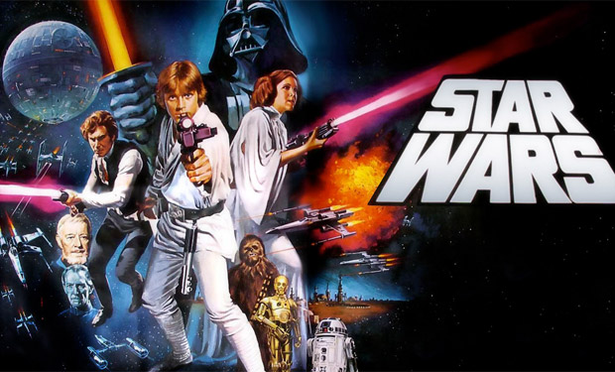
Star Wars: Main Title/Rebel Blockade Runner
Composed by John Williams
By Tyler Richins

Slide 2
John Williams
John Williams was born on February 8, 1932. He is one of the most successful film composers of all time.
He has composed film scores for many other popular and well known movies such as Jaws, Harry Potter, and Indiana Jones.
He was the first inductee to the Hollywood Bowl Hall of Fame on June, 23, 2000.

Slide 3
Basic Information on Song
Star Wars: Main Title/Rebel Blockade Runner is in major mode and has two themes (A and B).
Theme A played on the opening titles for all the Star Wars films, and is associated as the theme song for the entire Star Wars saga.
Theme B is associated with the rebel alliance. It’s used in the films end credits.
It has a semi-wide dynamical range and a narrow tempo range. Most Segments of the piece are either Presto or vivace, with one short segment vivace. The dynamics in the song range from mezzo-piano to fortissimo.

Slide 4
Basic Information on Song (cont.)
Star Wars: Main Title/Rebel Blockade Runner is in duple compound meter.
When the movie Star Wars Episode IV: A New Hope premiered on May 25, 1977 a disco version of the theme song by Meco became America’s number one song later that summer.
In 2005, it was honored by the American Film Institute for the as the most memorable film score of all time.

Slide 5
Awards
Star Wars: Main Title/Rebel Blockade Runner was part of Williams film score for Star Wars Episode IV: A New Hope . This soundtrack received many awards, including 3 Grammy awards (Best Score Soundtrack for Visual Media, Best Instrumental Composition, and Best Pop Instrumental Performance).
It also won both the Golden Globe and Academy Award for Best Original Score, along with the BAFTA award for Best Film Music.

Slide 6
^{Time} | Musical Elements | Instrumentation
0:00-0:15 | Short Introduction and the First run through of the main theme (Theme A). Trumpets have the melody and percussion provides the accompaniment. Song is in the key of B flat major. | Brass (Trumpet emphasis) and Drums.
0:15-0:30 | Main Theme is repeated and slightly changed. Drums, strings and lower brass (trumpets and baritone) play together to provide accompaniment. Trumpets still have melody. Also at about 0:26 a transition begins and slight decrescendo in dynamics to from fortissimo to forte. | Brass, Strings (Violin emphasis in accompaniment), and woodwinds (for transition after 0:26).

Slide 7
0:30-0:45 | This whole section is a continuation of the transition. Melody is played by the violins. Crescendos at about 0:39 back to fortissimo to reintroduce another play of the main theme slightly modified (Theme A’). | Brass, Strings, Woodwinds, Xylophone, and Drums.
0:45-1:00 | Theme A’ is played throughout this section. Rather than trumpets, the melody is played by French Horns, and woodwinds and drums provide accompaniment rather than strings and drums. | Brass (French Horn Emphasis), Woodwinds, Xylophone, and Drums.
1:00-1:15 | Theme A’ ends. Tempo of song slightly increases as theme ends to create a climatic effect. Then another Transition begins with a new rapid, presto pace led by violins. | Violins, Brass, Drums, and Xylophone.

Slide 8
1:15-1:30 | Transition continues. At 1:25 a short cadenza by the piccolo starts. Tempo slows down to Andante and decrescendos to mezzo-forte during cadenza. | Woodwinds, Brass, Strings (Violin emphasis), Xylophone
1:30-1:45 | Rapid increase in tempo to Presto by Violins. Also crescendos quickly back to Fortissimo. Also key changes to F major to introduce Theme B (which represents the rebel alliance). | Brass, Strings, and Drums.
1:45 | Theme B continues. Theme B is the constant repeating of brass block chords in intervals of a third that progress in parallel motion. Then trombones are emphasized and take melody as closing theme is introduced. | Brass (Trombone emphasis), Xylophone, and Drums.
2:00-2:14 | Trumpets play another melody in harmony with trombones. Song decrescendos and slows in Tempo as string basses play final notes. | Brass (Trombone and Trumpet emphasis), Drums, and String Bass.

